Slide 1

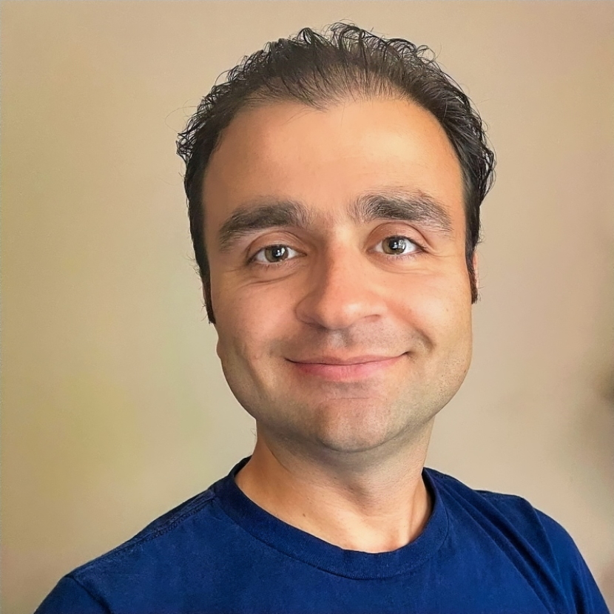
That’s me in the corner...
Notes:
I had some education background.

Slide 2





Education
BSc
MSc
MSc + PhD
All in Computer Science
Notes:
I had some education background.

Slide 3




Work Experience
Telecom
Automotive
Tech Startup
All to Develop Software
Ring Factory
Notes:
I did work in the industry!

Slide 4

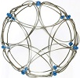


Recently
Manufacturing
Beulah
Works
Defense
Ring Factory
All to Consult Software
Business
Notes:
And now what I am doing other than being an assistant professor here at Ball State.

Slide 5




Current
Assistant Professor
Director
All to Teach Software
Notes:
And now what I am doing other than being an assistant professor here at Ball State.

